Slide 1
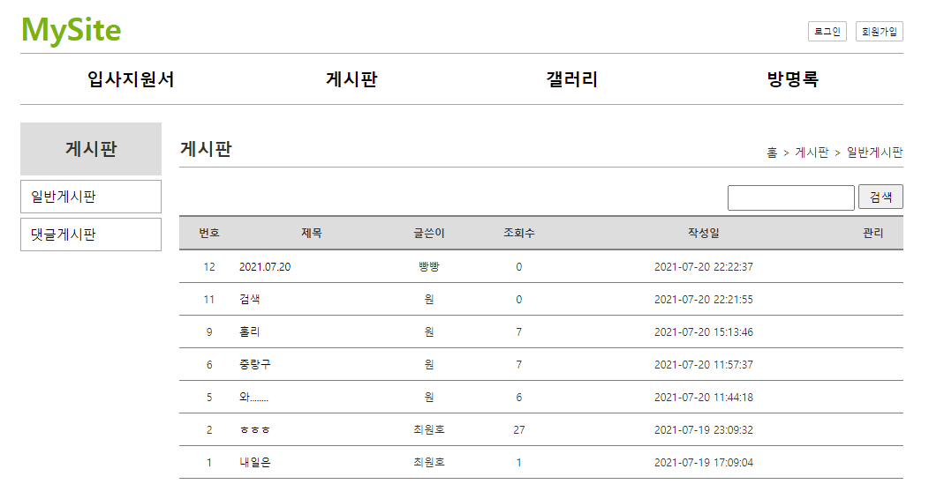
mysite 개요 및 분석
01
분석-list
Tomcat
http://localhost:8088/mysite/board?action=list
Rqeust(요청)
mysite
Rquest
파라미터
action=list
Contoller
(servlet)객체
Dao 객체
list일때
getBoardList()
Rqeust(요청)
Request header
파라미터: action=list
Request body
Response(응답)
response
Response(응답)
Response header
Response body (html)
DB

Slide 2
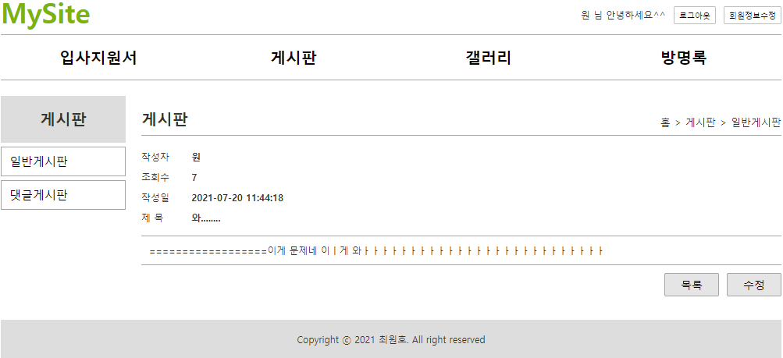
mysite 개요 및 분석
01
분석-read
http://localhost:8088/mysite/board?action=read
Tomcat
Rqeust(요청)
mysite
Rquest
파라미터:
Read
Contoller
(servlet)객체
Dao 객체
read일때
getBoard
(int no)
Rqeust(요청)
Request header
Request body
*포워드
response
read.jsp
객체
Response(응답)
DB
Response(응답)
Response header
Response body

Slide 3
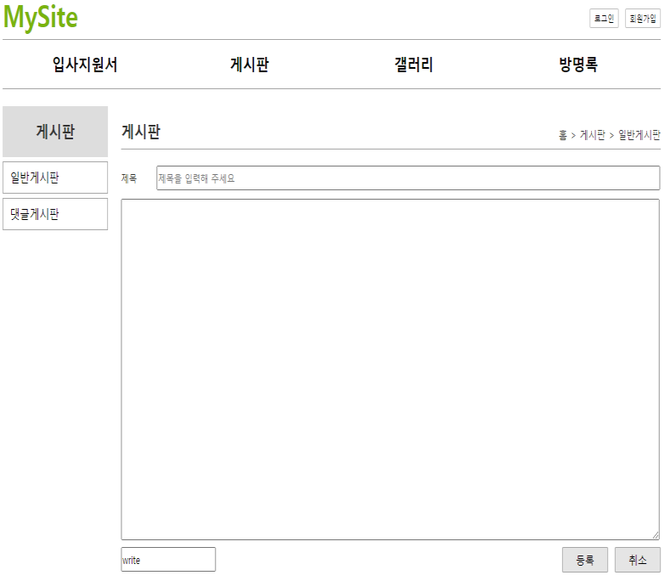
mysite 개요 및 분석
01
분석-writeForm
http://localhost:8088/mysite/board?action=writeForm
Tomcat
Rqeust(요청)
mysite
Rquest
파라미터:
writeForm
Contoller
(servlet)객체
writeForm일때
Rqeust(요청)
Request header
Request body
*포워드
response
writeForm.jsp
객체
Response(응답)
Response(응답)
Response header
Response body

Slide 4
mysite 개요 및 분석
01
분석-write
http://localhost:8088/mysite/board?action=write
Tomcat
Rqeust(요청)
mysite
Rquest
파라미터:
write
Dao 객체
boardInsert
(BoardVo)
Contoller
(servlet)객체
Rqeust(요청)
write일때
Request header
Request body
Response
//리다이렉트
Response(응답)
DB
Response(응답)
Response header
Response body

Slide 5
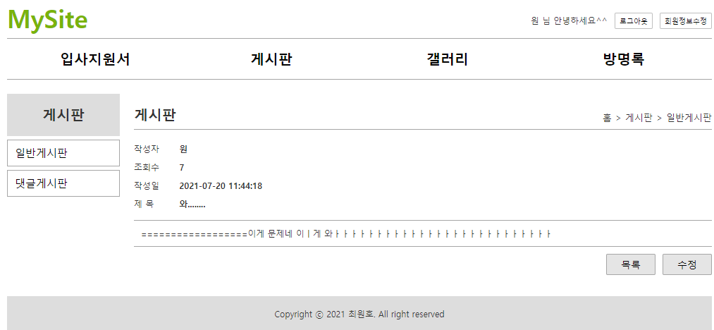
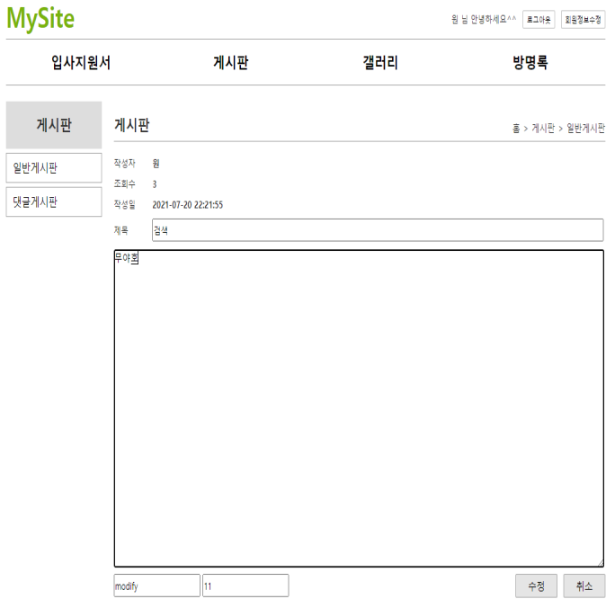
mysite 개요 및 분석
01
분석-modifyForm
http://localhost:8088/mysite/board?action=modifyForm
Tomcat
Rqeust(요청)
mysite
Rquest
파라미터
action=modifyForm
Contoller
(servlet)객체
modifyForm
일때
Rqeust(요청)
Request header
파라미터: action=modifyForm
Request body
*포워드
Response(응답)
response
modifyForm.jsp
객체
Response(응답)
Response header
Response body (html)

Slide 6

mysite 개요 및 분석
01
분석-modify
http://localhost:8088/mysite/board?action=modify
Tomcat
Rqeust(요청)
mysite
Rquest
파라미터:
modify
Dao 객체
boardUpdate
(BoardVo)
Contoller
(servlet)객체
Rqeust(요청)
modify일때
Request header
Request body
Response
//리다이렉트
Response(응답)
DB
Response(응답)
Response header
Response body

Slide 7
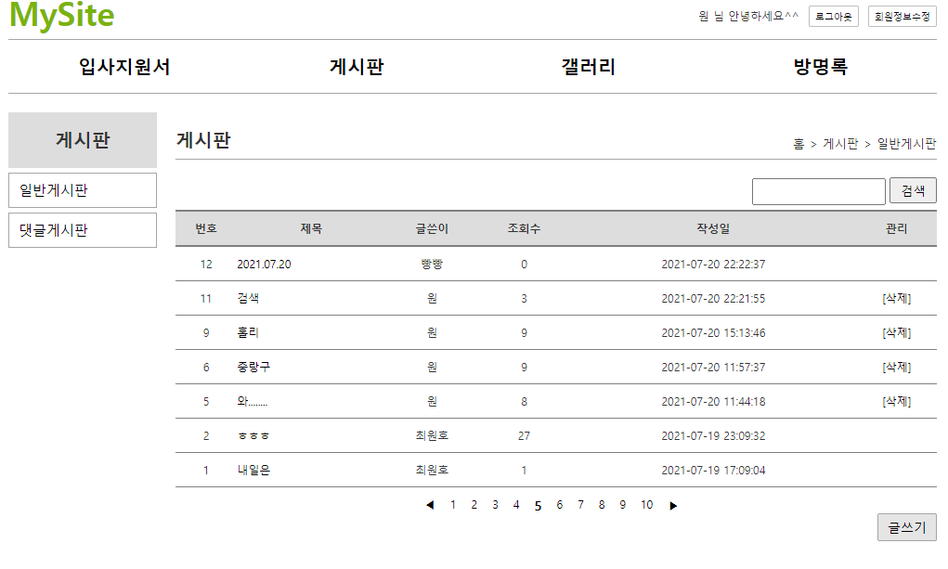
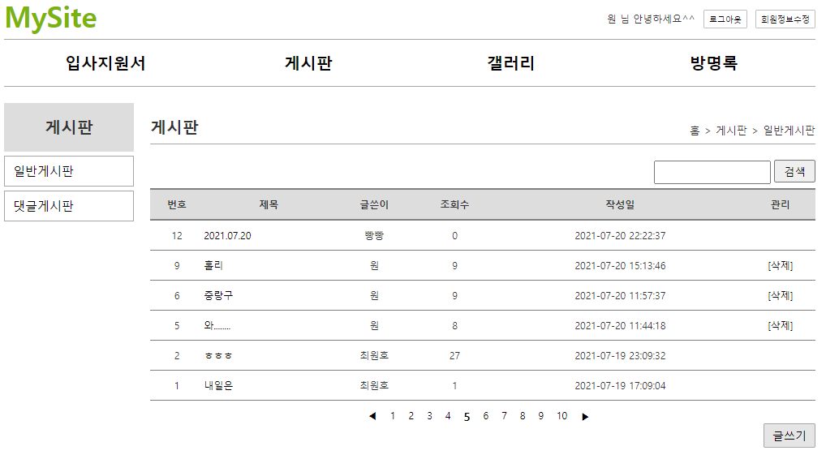
mysite 개요 및 분석
01
분석-delete
http://localhost:8088/mysite/board?action=delete
Tomcat
Rqeust(요청)
mysite
Rquest
파라미터:
delete
Dao 객체
boardDelete
(int no)
Contoller
(servlet)객체
Rqeust(요청)
delete일때
Request header
Request body
Response
//리다이렉트
Response(응답)
DB
Response(응답)
Response header
Response body

Slide 8
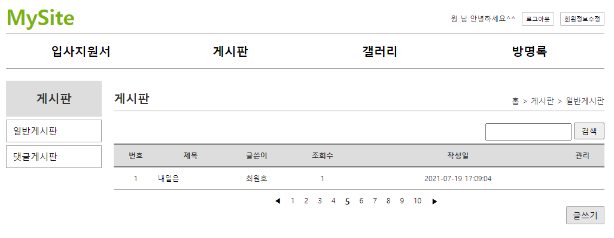
mysite 개요 및 분석
01
분석-delete
http://localhost:8088/mysite/board?action=search
Tomcat
Rqeust(요청)
mysite
Rquest
파라미터:
search
Dao 객체
getBoardList
(keyword)
Contoller
(servlet)객체
Rqeust(요청)
search일때
Request header
Request body
Response
//리다이렉트
Response(응답)
DB
Response(응답)
Response header
Response body

